Slide 1
Govt. Model /Adarsh Sr. Sec. Schools

Slide 2
Introduction of Model Schools
21 Govt. Model Sr. Sec. Schools were opened in Punjab in educationally backward blocks during the year 2009-10 under the centrally sponsored scheme.
Initially expenditure was borne by the Govt. of India and the State Govt. 75:25 ratio.
From 2015-16, Centre Share is de-linked and now it is State Govt. liability.

Slide 3
21 Model Sr. Sec. Schools Situated in 8 Districts (Bathinda, Fazilka, Ferozepur, Mansa, Muktsar, Patiala, Sangrur and Tarn Taran).
Building of each Govt. Model Sr. Sec. Schools at a cost of Rs. 3.02 Crores.
10 to 15 acres of land provided by village Panchayats free of cost.

Slide 4
Infrastructure facilities are of the standard of a Kendriya Vidyalaya.
Affiliated to the CBSE, New Delhi.
These Govt. Model Sr. Sec. Schools are giving education to students right from 6th to 10+2 classes.
The medium of instructions in these schools is English.
Staff appointed in these schools are on contract basis, salary structure is as per Punjab Govt. including allowances.

Slide 5
Introduction of Adarsh schools
6 Govt. Adarsh Sr. Sec. Schools working under Punjab Education Development Board (PEDB).
Out of 6 Govt. Adarsh Sr. Sec. Schools 4 are functional from 01-08-2010 and 2 are functional from 2011-12.
Total 100% expenditure is borne by the State Govt. Punjab.
These schools are situated at boarder areas and backward areas of 5 Districts (Bathinda, Ferozepur, Tarn Taran, Gurdaspur & Ropar).
Staff appointed in these schools are on contract basis, salary structure is as per Punjab Govt. including allowances.

Slide 6
Admission process in Model & Adarsh Schools
Admission process of these schools are done according to online lottery system and it has started from the session 2016-17.

Slide 7
Purpose of Model & Adarsh schools
The purpose of these schools are to impart quality education to poor students of Border and Education Backward Block Areas.

Slide 8
Classwise strength of students in Model Schools
Sr. No | School Name | District | Student Strength (2017-18)
 |  |  | 6 | 7 | 8 | 9 | 10 | 11 | 12 | Total
1 | GMSSS, Rai Ke Kalan | Bathinda | 60 | 66 | 60 | 57 | 32 | 34 | 36 | 328
2 | GMSSS, Natheha | Bathinda | 27 | 35 | 24 | 15 | 8 | 7 | 0 | 116
3 | GMSSS, Ram Nagar | Bathinda | 69 | 65 | 70 | 49 | 44 | 29 | 12 | 333
4 | GMSSS,Gidderanwali | Fazilka | 67 | 67 | 66 | 59 | 43 | 5 | 5 | 312
5 | GMSSS, Dhrangwala | Fazilka | 70 | 64 | 61 | 40 | 36 | 0 | 0 | 271
6 | GMSSS, Kaurianwali | Fazilka | 73 | 70 | 71 | 65 | 44 | 4 | 9 | 335
7 | GMSSS Chak Mochan Wala | Fazilka | 70 | 71 | 68 | 71 | 58 | 0 | 0 | 338
8 | GMSSS Guddar Dhandi | Ferozepur | 70 | 70 | 70 | 70 | 57 | 39 | 18 | 384
9 | GMSSS Usmanwala | Ferozepur | 61 | 51 | 51 | 54 | 31 | 25 | 28 | 286
10 | GMSSS, Hiron Kalan | Mansa | 52 | 62 | 50 | 52 | 31 | 37 | 21 | 300
11 | GMSSS, Datewas | Mansa | 64 | 50 | 53 | 59 | 41 | 12 | 13 | 286
12 | GMSSS, Kulrian | Mansa | 69 | 75 | 61 | 59 | 39 | 47 | 35 | 367
13 | GMSSS, Mian | Mansa | 63 | 61 | 60 | 52 | 34 | 0 | 0 | 270
14 | GMSSS, Jatana Kalana | Mansa | 58 | 64 | 67 | 48 | 40 | 0 | 0 | 277
15 | GMSSS, Phullukhera | Muktsar | 33 | 51 | 48 | 43 | 21 | 12 | 9 | 214
16 | GMSSS, Bhagsar | Muktsar | 53 | 36 | 55 | 55 | 28 | 42 | 24 | 281
17 | GMSSS CHUNAGRA | Patiala | 70 | 70 | 70 | 67 | 52 | 63 | 35 | 415
18 | GMSSS, Lehal Kalan | Sangrur | 65 | 69 | 68 | 68 | 61 | 27 | 35 | 363
19 | GMSSS Mandvi (Andana) | Sangrur | 69 | 69 | 70 | 65 | 51 | 18 | 31 | 358
20 | GMSSS, Sheron | Sangrur | 79 | 68 | 58 | 43 | 41 | 46 | 32 | 346
21 | GMSSS, Valtoha | Tarntaran | 70 | 69 | 69 | 61 | 35 | 39 | 8 | 351
 | Total |  | 1312 | 1303 | 1270 | 1152 | 827 | 486 | 351 | 6531

Slide 9
Classwise strength of students in Adarsh Schools-2017-18
Class | KG | 1st | 2nd | 3rd | 4th | 5th | 6th | 7th | 8th | 9th | 10th | 11th | 12th | Total
Bhikhariwal | 34 | 57 | 49 | 45 | 42 | 57 | 59 | 38 | 57 | 39 | 19 | 6 | 4 | 506
Kot Dhandal | 67 | 68 | 60 | 60 | 59 | 64 | 54 | 63 | 68 | 62 | 37 | 26 | 0 | 688
Baler Khurd | 71 | 70 | 70 | 69 | 70 | 70 | 70 | 70 | 63 | 46 | 28 | 7 | 3 | 707
Bukan Khan Wala | 54 | 60 | 53 | 65 | 57 | 49 | 55 | 64 | 69 | 71 | 38 | 14 | 12 | 661
Canal Colony | 70 | 70 | 68 | 70 | 71 | 70 | 70 | 69 | 70 | 64 | 38 | 50 | 25 | 805
Lodhipur | 69 | 72 | 71 | 78 | 72 | 80 | 74 | 77 | 69 | 66 | 44 | 20 | 11 | 803
Total | 365 | 397 | 371 | 387 | 371 | 390 | 382 | 381 | 396 | 348 | 204 | 123 | 55 | 4170

Slide 10
CBSE Board Result (2016-17) pass percentage
S.N. | Model Schools | 10th class | 12th class
 |  |  | Science | Humanities | Commerce
1 | Rai Ke Kalan, Bathinda | 100% | No student appeared in +2 during 2016-17.
2 | Natheha, Bathinda | 100%
3 | Ram Nagar, Bathinda | 100%
4 | Giddarn Wali, Fazilka
5 | Dharang Wala, Fazilka | 98.15% | No student appeared in +2 during 2016-17.
6 | Kaurian Wali, Fazilka | 100% | 50% | 66.67% | NIL
7 | Chak Mochan Wala, Fazilka
8 | Gudar Dhandi, Ferozepur | 100% | 33.3% | 66.67% | NIL
9 | Usman Wala, Ferozepur | 91.42% | No student appeared in +2 during 2016-17.
10 | Hiro Kalan, Mansa | 91.8%
11 | Datewas, Mansa | 100%
12 | Kulrian, Mansa | 100% | 91.67% | 100% | 62.5%
13 | Mian, Mansa | 100% | No student appeared in +2 during 2016-17.
14 | Jatana kalan, Mansa | 91%
15 | Phulu Khera, Mukatsar | 100% | NIL | 22.2% | NIL
16 | Bhagsar, Mukatsar | 100% | 100% | 25% | NIL
17 | Chunagra, Patiala | 100% | No student appeared in +2 during 2016-17.
18 | Lehal Kalan, Sangrur | 76.2%
19 | Mandvi, Sangrur | 100% | 100% | 100% | NIL
20 | Sheron, Sangrur | 100% | 66.67% | 80% | 100%
21 | Valtoha, Tarn-Taran | 100% | 100% | 100% | NIL

Slide 11
CBSE Board Result (2016-17) pass percentage
S.N. | Adarsh Schools | 10th class | 12th class
 |  |  | Science | Humanities | Commerce
1 | Bhikhariwal, Gurdaspur | 100% | 75% | 100% | NIL
2 | Kot Dhandal, Gurdaspur | 100% | No student appeared in +2 during 2016-17.
3 | Baler Khurd, Tran-Taran | 100% | 90.9% | 80% | NIL
4 | Bukan Khan Wala, Ferozepur | 100% | 66.67% | NIL | NIL
5 | Canal Colony, Colony | 98.43% | 68.75% | 60% | NIL
5 | Lodhipur, Ropar | 100% | 94.4 | NIL | NIL

Slide 12
Financial Status for Model Schools
Sr. No. | Financial Year | Funds Proposed | Funds Released | Remarks
1 | 2016-17 | 20 Crores | 13.67 | Non salary funds were not released.
2 | 2017-18 | 25 Crores | 13.67 | Non salary funds were not released.

Slide 13
Financial Status for Adarsh Schools
Sr. No. | Financial Year | Funds Proposed | Funds Released | Remarks
1 | 2016-17 | 9.5 Crores | 8.45 Crores
2 | 2017-18 | 11 Crores | 9H00 Crores

Slide 14
Detail of various posts (Sanctioned, filled & Vacant)- Model schools
Sr. No. | Name of the post | Sanctioned posts | Filled Posts | Vacant posts | Remarks
1 | Principal | 21 | 11 | 10
2 | PGTs | 206 | 81 | 125
3 | TGTs | 252 | 112 | 140
4 | Drawing Teacher | 21 | 17 | 4
5 | Librarian | 21 | 14 | 7
6 | Data Entry Operator | 21 | 5 | 16
7 | Group-D | 63 | 63 | 0
 | Total | 605 | 303 | 302

Slide 15
Details of Posts in Govt. Adarsh Sr. Sec. Schools
Sr. No. | Post | No. of Sanctioned Posts | No. of Filled Posts | No. of Vacant Posts | Remarks
1 | Principal | 6 | 5 | 1
2 | PGT | 66 | 24 | 42
3 | TGT | 84 | 65 | 19
4 | Drawing Teacher | 6 | 5 | 1
5 | Primary Teachers | 60 | 9 | 51
6 | Librarian | 6 | 5 | 1
7 | Data Entry Operator | 6 | 4 | 2
 | Total | 234 | 117 | 117

Slide 16
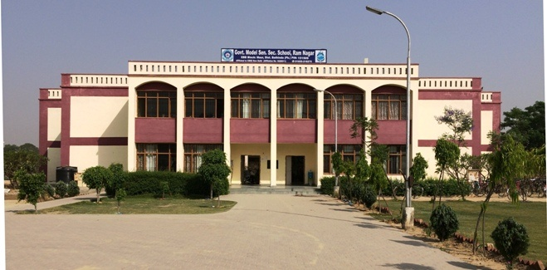
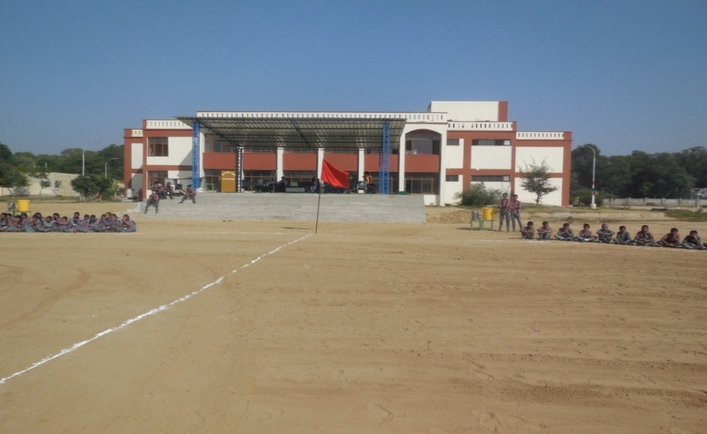
Infrastructure
Rooms: Classrooms Medical Rooms, Sports Room, Smart Class
Labs - Physics, Chemistry, Biology, Computer, Language Lab, Mathematics Lab,
Library
Playgrounds- Football, Kho-Kho, Volleyball, Handball & Badminton, 400m Athletic Track
Kitchen sheds
Toilets

Slide 17
Problems / Suggestions
Shortage of staff: Principal, PGT, TGT, Clerk.
Maintenance of Building.
    School needs RO Plant for drinking water.
No supply of Cycles for Girls, School Uniform and NCERT Books & Scholarship to students.
Cycle Shed.
Auditorium / Multipurpose Hall.
Trainings: CCE and Finance related.
Staff should be regularized.

Slide 18
Thank you

